Slide 1
20
Session 20 of 24
Neural networks and deep learning, without the maths wall
What is a neural network, and when is one the right tool?
Jotham Martin Wambi, KLAi Professional Learning
Session 20 Neural networks and deep learning, without the maths wall
1
Notes:
Today we open the box that everyone talks about, the neural network, and we do it without any hard maths. Last session you forecast malaria cases and built a pipeline. We'll build one neuron by hand, watch a tiny network learn in the browser, then train one on the loans and compare it with the forest. You will also see a model that someone else trained, which you can use for free.

Slide 2
By the end of today
How the two hours run
Describe layers, weights and training in plain words.
Recall and warm-up
10 min
Concepts and explanation
30 min
Train a small network and see it overfit.
Live demonstration
25 min
Say when a simpler model is better.
Break
5 min
Guided lab
40 min
Check and wrap-up
10 min
Session 20 Neural networks and deep learning, without the maths wall
2
Notes:
Today has two live moments. The first is one neuron computed by hand in numpy. The second is TensorFlow Playground in your browser, where you watch a network learn and overfit. In the lab you train a network on the loans and compare it with the forest. By the end you can describe layers, weights and training in plain words, and say when a simpler model is the better choice, which for a table is often the case.

Slide 3
Vocabulary
Word | Plain meaning | In a spreadsheet
Neuron | A small calculation that multiplies inputs by weights, adds them and bends the total. | One SUMPRODUCT cell
Weight | A number that says how much one input counts. Training adjusts it. | The multiplier beside each input
Activation function | The bend applied to a neuron's total, such as sigmoid or ReLU. | An IF or MAX wrapped around a formula
Hidden layer | A row of neurons between the inputs and the output. | Helper columns between the data and the answer
Loss | One number that says how wrong the guesses are. Training tries to shrink it. | The total of an error column
Learning rate | How big a step each correction takes. | How far you move a cell on each try
Epoch | One full pass through all the training data. | One pass down the whole sheet
Pretrained model | A model already trained by someone else, used as it is. | A filled in template workbook
Session 20 Neural networks and deep learning, without the maths wall
3
Notes:
Eight words today. A neuron is one small calculation, like a SUMPRODUCT cell. A weight is a multiplier, and an activation function is the bend. A hidden layer is a row of helper columns. The loss is your error total, and the learning rate is the size of each nudge. An epoch is one full pass over the data. A pretrained model is a template someone has already filled in for you.

Slide 4
Warm-up from Session 19
1
Why do we split a time series by date and never at random?
A random split lets the model peek at the future. Train on the past, test on later months.
2
What must a forecast beat before we trust it?
The seasonal naive baseline: repeat the same month from last year.
Session 20 Neural networks and deep learning, without the maths wall
4
Notes:
Time series first. Two questions from Session 19.
First. Why do we split a time series by date and never at random? Have a think.
Because a random split lets the model peek at the future. You train on the past and test on the months that come later, the way real life works.
Second. What must a forecast beat before you trust it? No rush.
The seasonal naive baseline. That's the forecast that simply repeats the same month from last year. If a clever model can't beat that, it isn't worth using. Keep that idea close today, because a neural network faces the same test.

Slide 5
A neuron is a weighted sum plus a bend
One neuron is a small calculation. It adds up its inputs, each multiplied by a weight, then bends the total.
Weights
One multiplier per input. A big weight means that input matters.
Add up
Multiply, add, then add one starting number, the bias.
Bend
Squash the total into a score between 0 and 1.
Session 20 Neural networks and deep learning, without the maths wall
5
Notes:
The smallest piece of a neural network is one neuron.
You already build one in a spreadsheet. Take a few input cells, a column of multipliers beside them, and a SUMPRODUCT formula. Add one extra number on the end. That's the weighted sum.
The multipliers are called weights. A big weight says that input matters a lot. A weight below zero says that input pushes the answer down.
The extra number is called the bias. It sets where the neuron starts before any input arrives. This bias is a different idea from the bias in bias and variance. Here it is just a starting number.
Then comes the bend. We take the total and squash it into a score between zero and one. You met that squash in Session 15 as the sigmoid curve. So a neuron is the logistic regression you already know, packaged as a small unit.

Slide 6
One neuron by hand with NumPy
import numpy as np
x = np.array([2, 0.4, 0.6])
w = np.array([0.9, -1.2, 1.5])
b = -1.0
z = np.dot(x, w) + b
print('weighted sum plus bias:', round(z, 2))
p = 1 / (1 + np.exp(-z))
print('after the bend:', round(p, 3))
1
Three inputs for one loan: late payments, savings in millions, repayment burden. Three weights and a bias.
2
np.dot multiplies each pair and adds them up. It is SUMPRODUCT.
3
The sigmoid bends 1.22 into a score of 0.772.
Output
weighted sum plus bias: 1.22
after the bend: 0.772
Session 20 Neural networks and deep learning, without the maths wall
6
Notes:
We compute one neuron live, with no library except NumPy.
We describe one loan with three numbers. Two late payments, savings of four hundred thousand shillings written as zero point four million, and a repayment burden of zero point six. The weights say late payments and burden push risk up, and savings pushes it down. The bias is minus one.
The dot function multiplies each input by its weight and adds the results. It's SUMPRODUCT. Add the bias and the weighted sum is one point two two.
Then the bend. One divided by one plus e to the power of minus z gives zero point seven seven two. So this neuron says the loan looks risky, with a score of about seventy seven percent. Every step was ours. A neural network is this calculation repeated many times.

Slide 7
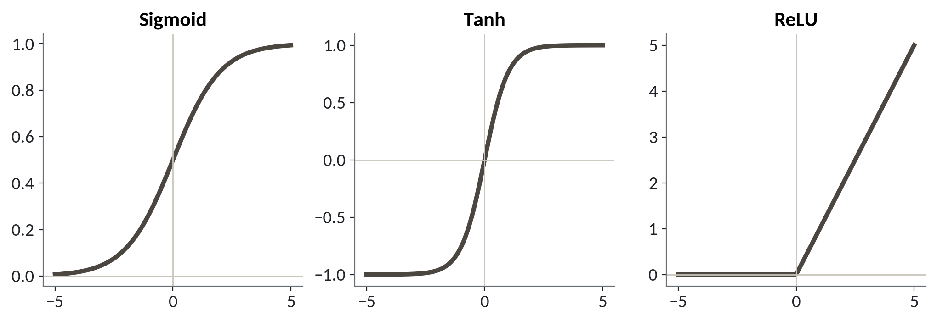
Activation functions bend the total
1
Sigmoid squashes any total into a score from 0 to 1.
2
Tanh does the same but runs from minus 1 to 1.
3
ReLU returns 0 for negative totals and passes positive ones through.
The bend is what lets a network learn more than a straight line.
Session 20 Neural networks and deep learning, without the maths wall
7
Notes:
The bend has a proper name. It's called an activation function, and here are the three you will meet most.
On the left, the sigmoid. Whatever total goes in, a score between zero and one comes out. That's the one we just used.
In the middle, tanh. It has the same S shape, but the scores run from minus one to one.
On the right, ReLU. It looks odd, and it's the most popular of the three. If the total is below zero it gives zero. Above zero it passes the total straight through.
Why do we bend at all? Without a bend, stacking neurons would still give you a straight line, however many you stack. The bend is what lets a network draw curves.

Slide 8
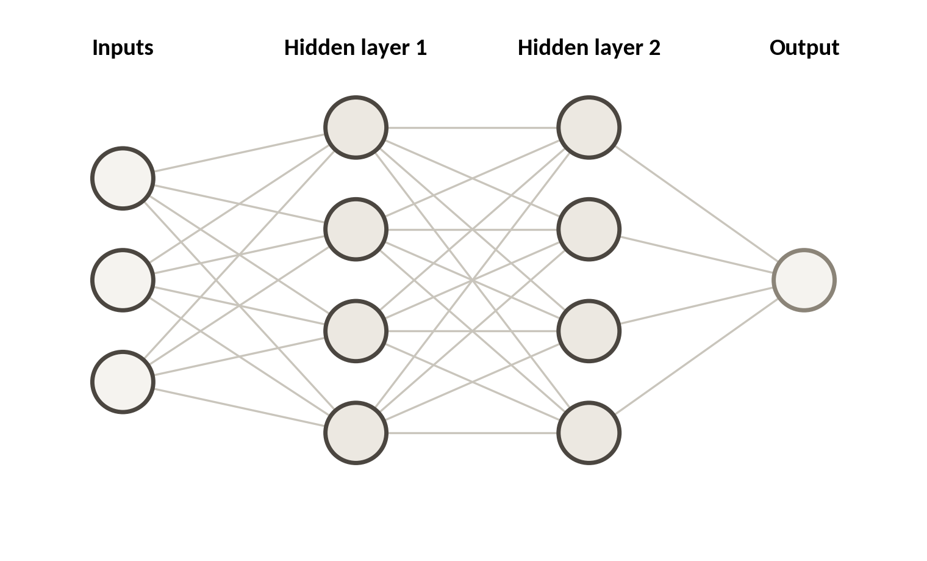
Layers stack neurons into a network
Put neurons side by side and you have a layer. Feed one layer into the next and you have a network.
Input layer. Your columns go in here. One node per column.
Hidden layers. Neurons in the middle. They build new columns from the old ones.
Output. The final score, such as the chance a loan defaults.
Session 20 Neural networks and deep learning, without the maths wall
8
Notes:
Next we stack them. The picture on the right shows a small network.
On the left are three input nodes. Think of them as three columns of your loans table. Every input connects to every neuron in the first hidden layer, and each line carries its own weight.
A hidden layer is a row of neurons between the input and the answer. It's hidden because you never see its values in your data. In a spreadsheet it's like helper columns that you build from the original columns, then build more helper columns from those.
Here there are two hidden layers of four neurons each. The last circle on the right is the output, the single score. A network is a pile of small weighted sums, each one bent. The weights are what training adjusts.

Slide 9
Training is repeated small corrections
Guess
Guess. Run the loans through the network.
Measure. Compute the loss, the size of the error.
One pass over all the data is an epoch
Repeat
Measure
Nudge. Shift each weight a little to cut the loss.
Repeat. Do it again with the new weights.
Nudge
Session 20 Neural networks and deep learning, without the maths wall
9
Notes:
So how does a network find good weights? It starts with random ones, and then it corrects itself, over and over.
First, it guesses. It runs the loans through with its current weights and produces a score for each.
Second, it measures. The loss is one number that says how wrong the guesses were. It's the total of your error column in a spreadsheet, the cell that Solver tries to shrink.
Third, it nudges. Each weight moves a small step in the direction that makes the loss smaller.
Fourth, it repeats with the new weights. One full pass through all the data is called an epoch. A network may run for tens or hundreds of epochs. Each correction is tiny. The skill is in doing a great many of them.

Slide 10
A teaching toy: one weight learns
Output
import numpy as np
x, target = 2.0, 6.0
w, lr = 0.0, 0.05
for step in range(1, 9):
pred = w * x
loss = (pred - target) ** 2
grad = 2 * (pred - target) * x
w = w - lr * grad
print(step, round(w, 3), round(loss, 3))
1 1.2 36.0
2 1.92 12.96
3 2.352 4.666
4 2.611 1.68
5 2.767 0.605
6 2.86 0.218
7 2.916 0.078
8 2.95 0.028
1
One input, one weight, and a target of 6. The right weight is 3.
2
grad says which way, and how steeply, the loss slopes. lr is the learning rate.
3
The weight creeps toward 3 and the loss falls each step.
Session 20 Neural networks and deep learning, without the maths wall
10
Notes:
This is a teaching toy, a network with one weight, so you can watch training happen.
The input is two, and we want the answer to be six. So the perfect weight is three, but the computer doesn't know that. It starts the weight at zero.
Each turn of the loop does the four steps we just saw. It predicts, then measures the loss as the squared error, then finds the slope, then moves the weight. The learning rate, lr, is the size of each step. Here it's zero point zero five.
Read the printout. After step one the weight is one point two and the loss was thirty six. By step eight the weight is two point nine five and the loss is under three hundredths. The loss falls every step, and the steps get smaller as it nears the answer. A real network does this for thousands of weights at once.

Slide 11
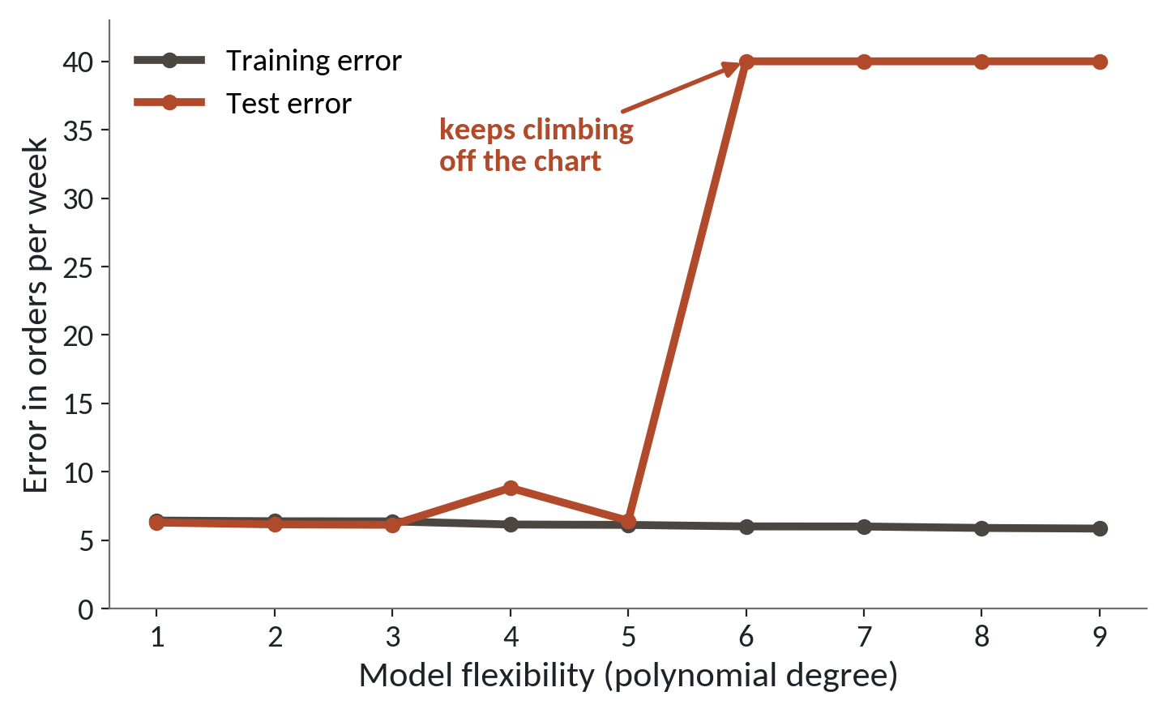
Overfitting again: more flexibility, worse test
1
Training error stays low as the model gets more flexible.
2
Test error jumps once the model is too flexible.
3
A network with many neurons can memorise its training rows too.
Same lesson as Session 17: judge every model on rows it has not seen.
Session 20 Neural networks and deep learning, without the maths wall
11
Notes:
You've met this picture before, in Session 17. Here the flexibility is the polynomial degree on the Jinja weeks, and the lesson matters even more for networks.
The dark line is training error. It stays low however flexible the model becomes.
The red line is test error. For the first few steps it follows the dark line. Then it shoots up. The model has stopped learning the pattern and started memorising the training rows.
A network with many layers and many neurons has a huge number of weights, so it can memorise easily. It can score close to perfect on the data it trained on, and then do badly on a new loan.
The cure is the one you already know. Hold back a test set and trust only the test score. The Playground will let you see this happen with your own eyes.

Slide 12
TensorFlow Playground: watch a network learn
A free page in your browser. No login and nothing to install. Everything is drawn live.
Pick a data set
Dots of two colours. The network must separate them.
Build the network
Choose features, add hidden layers, set neurons per layer.
Press play
Watch the epoch count rise and the colours settle.
Session 20 Neural networks and deep learning, without the maths wall
12
Notes:
TensorFlow Playground is a free page in your browser. It needs no login and nothing to install.
You begin by picking a data set. These are dots of two colours, and the network has to learn to separate the two groups.
Then you build the network. You choose which features go in, you add hidden layers, and you choose how many neurons each layer gets. You can also set the learning rate, pick the activation function, and turn on something called regularisation, which discourages huge weights.
Then you press play. Watch the epoch counter go up and the coloured background change as the network learns. Here you watch training happen. I'll show you one example, and then you try four challenges.

Slide 13
Playground: four challenges
1
Circle: solve the circle data set with one hidden layer
Tool and time
TensorFlow Playground
15 minutes
2
Spiral: fail with a few neurons, then succeed by adding neurons and layers
3
Noise: raise the noise on a data set and watch it overfit
You are done when
Four short notes written, each saying what you changed and what happened.
4
Rate: change the learning rate and activation and note what changes
5
Write what you saw for each in your notebook
Session 20 Neural networks and deep learning, without the maths wall
13
Notes:
Four challenges. Work in pairs if you like. The Playground is in your browser, and you'll record what you see in the notebook later.
First, the circle data set. Solve it with one hidden layer. Try a few neurons and see how few you need.
Second, the spiral. It's much harder. Start with a small network and let it fail. Then add neurons and layers until it succeeds. Notice how long it takes.
Third, noise. Raise the noise on a data set. Watch how the network starts to draw wiggly islands around single dots. That's overfitting, live. Then try regularisation and see if it calms down.
Fourth, change the learning rate and the activation function and say what happens.
For each one, write down what you changed and what you saw.

Slide 14
A network in scikit-learn on the loan data
from sklearn.pipeline import make_pipeline
from sklearn.impute import SimpleImputer
from sklearn.preprocessing import StandardScaler
from sklearn.neural_network import MLPClassifier
mlp = make_pipeline(
SimpleImputer(strategy='median'),
StandardScaler(),
MLPClassifier(hidden_layer_sizes=(16, 8),
max_iter=500, random_state=42))
mlp.fit(X_train, y_train)
1
Fill missing incomes, then scale every column. Networks need scaled inputs.
2
hidden_layer_sizes=(16, 8) means two hidden layers, 16 and 8 neurons.
3
fit trains it. Same fit and predict as every model so far.
Session 20 Neural networks and deep learning, without the maths wall
14
Notes:
Back to the Nile Microfinance loans. scikit-learn has a network called MLPClassifier. MLP stands for multi layer perceptron, which is just a network with hidden layers.
We use a pipeline, as in Session 19. First fill the missing incomes with the median. Then scale every column. Networks are fussy about this. If one column runs to millions of shillings and another is an age, the big column swamps the rest.
Then the network itself. The hidden layer sizes are sixteen and eight, so two hidden layers. Max iter says how many epochs to allow at most. Random state forty two keeps your result repeatable.
The last line is fit, the same word as every model since Session 14. X train and y train come from the split in the lab. Your score should land near the loan models from Session 17, an AUC of about zero point seven six. Your own run will differ a little from mine.

Slide 15
A mistake that stops the network
from sklearn.neural_network import MLPClassifier
raw = MLPClassifier(max_iter=500, random_state=42)
raw.fit(X_train_with_gaps, y_train)
1
Raw columns still hold empty incomes. The network has no rule for a blank.
Session 20 Neural networks and deep learning, without the maths wall
15
Notes:
You'll meet this error sooner or later. This time we skip the imputer and the scaler and hand the loans straight to the network, with the empty incomes still in place.
Python stops, and the last line of the message tells you the input contains NaN. That's the marker for a missing value. Some models in scikit-learn cope with gaps, but this one does not. A weighted sum has no way to add a blank.
You already know the fix. Fill the gaps first, as we did in Session 8, and put that step inside the pipeline so it can never be forgotten.

Slide 16
Network or forest on the loans table?
MLPClassifier
Random forest (Session 17)
Needs scaled, complete inputs
Needs little preparation
More settings to tune
Good results with few settings
Hard to explain a decision
Feature importance to read
Slower to train
Fast on a table this size
On a table of 8,000 loans, expect scores within a few points of each other.
Session 20 Neural networks and deep learning, without the maths wall
16
Notes:
Let's put the two side by side, on the same loans.
On the left, the network. It needs complete and scaled inputs. It has more settings to tune, layers, neurons, learning rate, epochs. It's hard to explain why it refused one loan. And it's slower.
On the right, the forest from Session 17. It takes the table nearly as it comes. It does well with few settings. You can read its feature importance, with care. And on a table this size it trains in seconds.
In the lab you'll compare them yourselves. The verdict is a prediction. I expect scores within a few points of each other. If the network wins by a hair, ask whether it's worth the extra work.

Slide 17
Pretrained models: use them, do not train them
Training a large network needs millions of examples and a lot of computing. Someone has already done it.
Download once
The model file is fetched the first time and kept in Colab.
Use it directly
Hand it your image and it returns labels with scores.
Read the model card
It states what the model was trained on and its licence.
Session 20 Neural networks and deep learning, without the maths wall
17
Notes:
Real image models have millions of weights and learn from millions of photos. Nobody in this room is going to train one, and you don't have to.
Think of a pretrained model as a template workbook that someone else has already filled in with the right weights. You download it once, and then you use it.
The first time you run it, Colab downloads the model file. After that it's kept for the session. You hand it an image and it gives back labels with scores.
One duty before you use any model. Read the model card. That's a short page that says what data it learned from, what it's good at, and what licence it comes under. Some licences allow business use and some don't. In Uganda you also owe the Data Protection and Privacy Act of 2019 a thought if the images show people. Check before you build on it.

Slide 18
Use a pretrained image classifier
from google.colab import files
from transformers import pipeline
name = list(files.upload())[0]
classifier = pipeline('image-classification')
print(classifier(name)[:3])
1
files.upload opens a file picker. Choose any photo of an object, with no people in it.
2
pipeline downloads the model once and wraps the network and its labels. It returns the best three guesses with scores.
Session 20 Neural networks and deep learning, without the maths wall
18
Notes:
Here's what using a pretrained model looks like. It's a few lines. I'm not running it live, because the first run downloads a model and that would take a while on our network, so look at the syntax.
First, files dot upload opens a file picker in Colab. You choose any photo of an object from your phone, with no people in it, and the code keeps its file name.
Then pipeline fetches the model once, loads it, and prepares the image for you. We ask for image classification and print the best three guesses with their scores.
A reminder for your own use. The model downloads once, and you must read its model card and licence before relying on it. Treat the labels as suggestions, and check a few by eye.

Slide 19
Where deep learning is worth using
Use a deep network for
Use a forest or regression for
Images and photos
Tables like loans
Sound and speech
Small data, a few thousand rows
Free text and language
Decisions you must explain
Deep learning is for raw images, sound and text. A table of loans is not that.
Session 20 Neural networks and deep learning, without the maths wall
19
Notes:
A word about scope before you leave.
Deep learning shines where the input is raw and has no tidy columns. Images, with their thousands of pixels. Sound. Free text. In those fields nothing else comes close, and it's why you hear so much about it.
Your loans table is different. It already has clean columns that a person chose, such as late payments and savings. For tables like this, a forest or a regression is usually as good as a network, and it's quicker, cheaper and easier to explain.
So the next time someone says we should use a neural network, ask what the input is. If it's a table, try the forest first. If it's photos or voice, then yes, and probably start from a pretrained model.

Slide 20
The network that scores 100 percent on training
What it looks like
Why it goes wrong
The fix
You train a big network and print its accuracy on the training rows. It is near perfect, so you report it to your manager.
A network with many weights can memorise its training rows. The score on data it has seen says nothing about a new loan.
Always report the score on a held back test set, and compare it with a simple baseline such as the forest.
Session 20 Neural networks and deep learning, without the maths wall
20
Notes:
This trap catches people on the day they first get a network working.
You build a large network, train it for many epochs, and print its accuracy on the same rows it learned from. The number is close to perfect. It feels like a triumph, and no error appears.
But a network with thousands of weights can simply memorise the answers. The training score tells you how well it remembers, and says nothing about a loan it has never met.
The fix is the same as in Sessions 14 and 17. Score on the test set, and compare against a plain baseline. If the test score is far below the training score, you've overfit.
Tell your manager the test number, every time.

Slide 21
Lab: a neuron, a loop and a network
1
Open the Session 20 notebook and run the setup cell
Tool and time
Google Colab and TensorFlow Playground
40 minutes
2
Build one neuron in NumPy and change its weights
3
Run the training loop and try two learning rates
You are done when
Every check cell prints correct and your sentence names which model you would choose.
4
Record your four Playground results in the notebook
5
Fit MLPClassifier on the loans and score it
6
Compare it with the forest and write one sentence
Session 20 Neural networks and deep learning, without the maths wall
21
Notes:
The first task is a function called neuron, the same weighted sum and bend you computed live. Open the Session 20 notebook, run the setup cell and start there. You have forty minutes in Google Colab.
The early tasks use NumPy only. You'll change a neuron's weights, then run the training loop from today with two learning rates, one that works and one that goes wrong.
Then the Playground. Do your four challenges in the browser and write down what you saw in the notebook cell that's waiting for you.
After that you fit the MLPClassifier on the loan data, score it on the test rows, and compare it with the random forest from Session 17. Your scores will land near what I described and differ a little. The last step is one sentence. Which model would you hand to a loans manager, and why?

Slide 22
Questions to finish
1
In plain words, what does one neuron do?
It multiplies each input by a weight, adds them with a bias, then bends the total with an activation function.
2
What happens inside training, and what is an epoch?
Guess, measure the loss, nudge the weights, repeat. An epoch is one full pass over the data.
3
Why might a forest beat a network on the loans table?
Tables suit forests. They need less tuning, explain more easily, and score about as well.
Session 20 Neural networks and deep learning, without the maths wall
22
Notes:
One neuron, one round of training, and forest against network. One question for each idea.
Question one. In plain words, what does one neuron do? Sit with it for a second.
It multiplies each input by a weight and adds them up with the bias. Then it bends the total with an activation function.
Question two. What happens inside training, and what's an epoch? Give that a moment.
The network guesses, measures the loss, nudges the weights a little, and repeats. An epoch is one full pass over all the data.
Question three. Why might a forest beat a network on the loans table? Think it over.
Because a table suits a forest. It needs less tuning, it's easier to explain, and it usually scores about as well.

Slide 23
Summary
A neuron is a weighted sum plus a bend. Layers of them make a network.
Training repeats small corrections to the weights. Judge the result on test rows.
Use deep learning for images, sound and text. Use a pretrained model, and try a forest on tables.
Next session. Text as data and meaning as numbers
Session 20 Neural networks and deep learning, without the maths wall
23
Notes:
One. A neuron is a weighted sum plus a bend, and layers of neurons make a network.
Two. Training is a great many small corrections to the weights, and you judge the result on rows the network has never seen, because it can overfit like any model.
Three. Deep learning is for images, sound and text, and there you start from a pretrained model after reading its card. For a table like the loans, try the forest first.
Next session we turn customer messages into numbers, so a computer can count words and compare meaning. Bring a few customer messages in mind that you would like to sort.

